Slide 1
Solution of Mid Term

Slide 2
Divide and Conquer

Slide 3
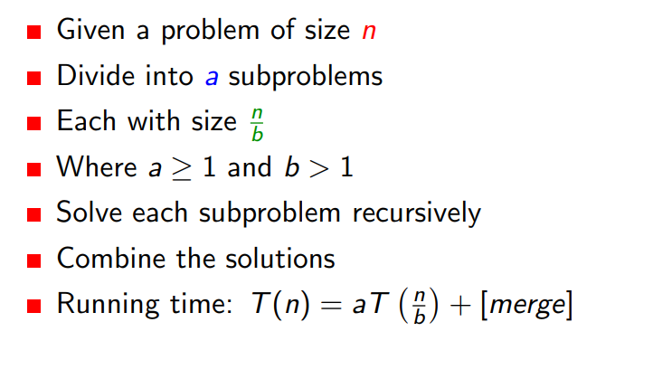

Slide 4
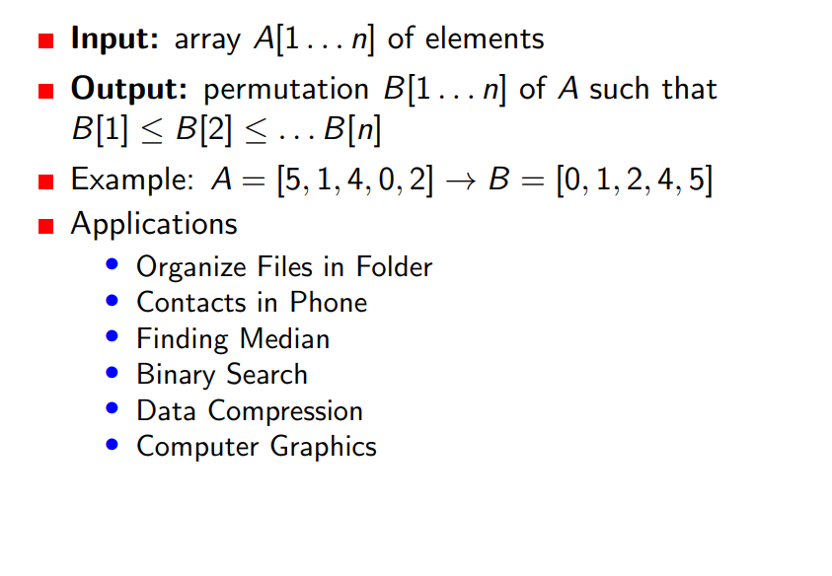
Merge sort

Slide 5
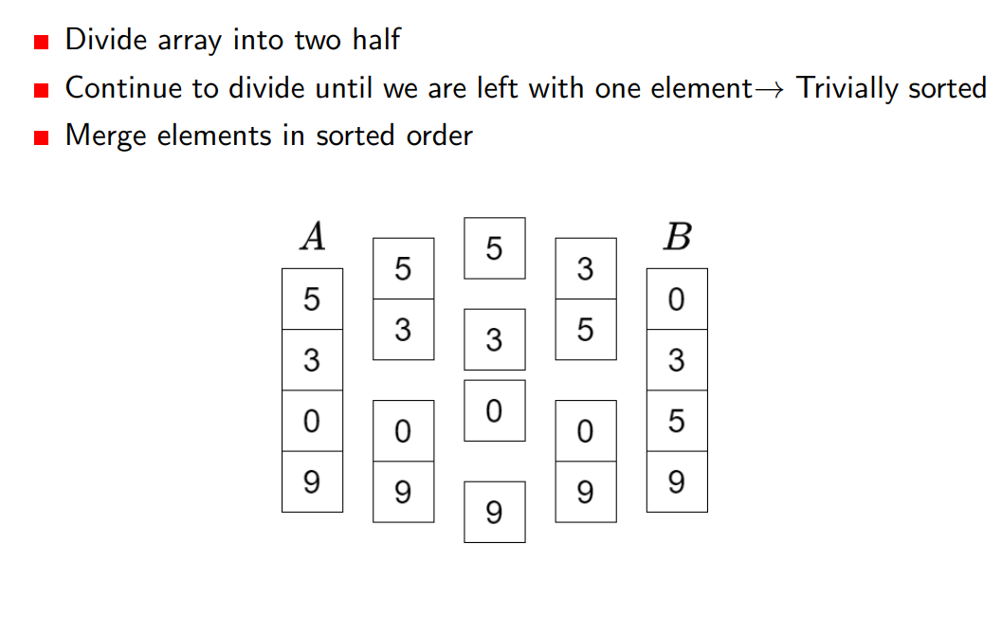
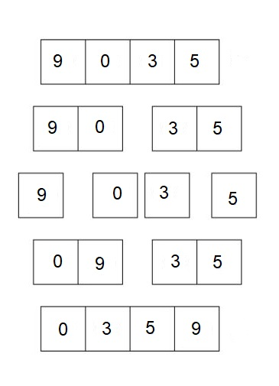
Merge sort

Slide 6
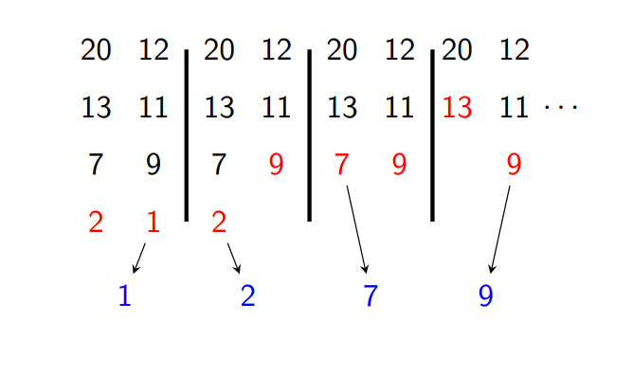
Merge Operation
2 Subarrays to merge: [20,13,7,2] and [12, 11, 9, 1]

Slide 7
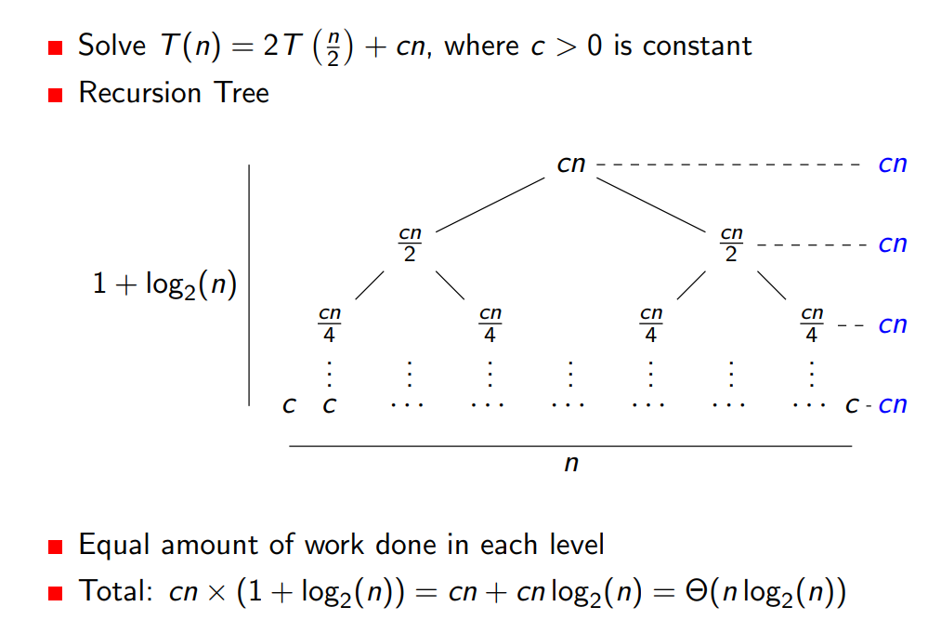
Solving Recurrences

Slide 8
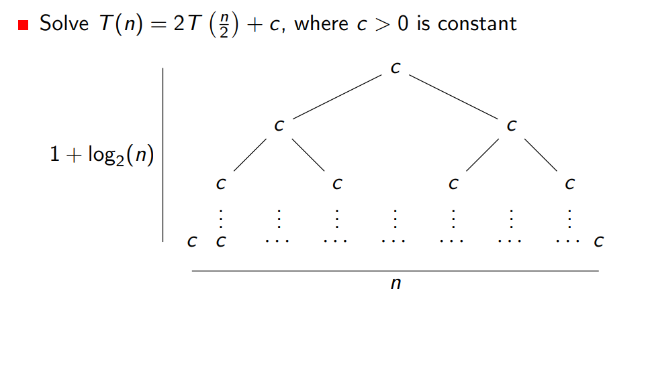
Solving Recurrences

Slide 9
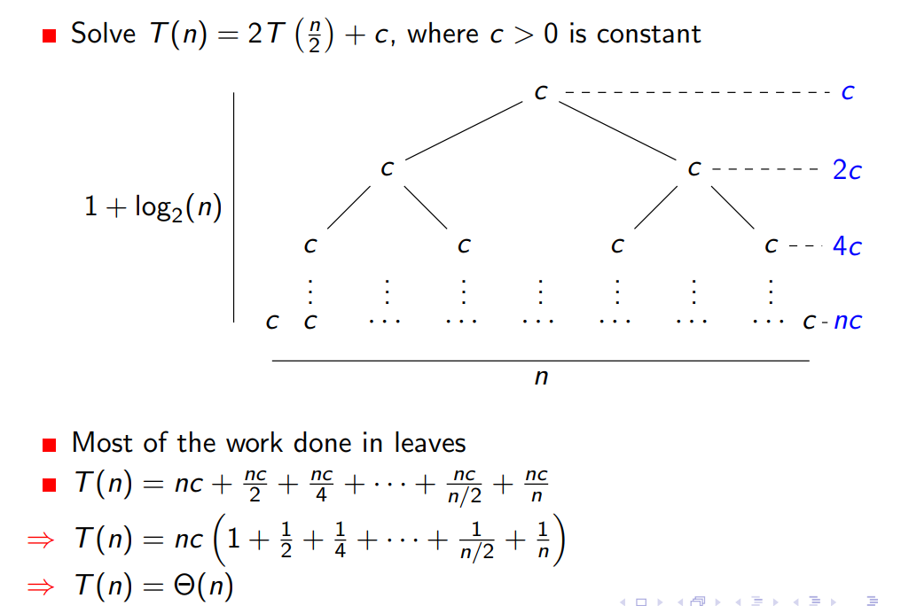
Solving Recurrences

Slide 10
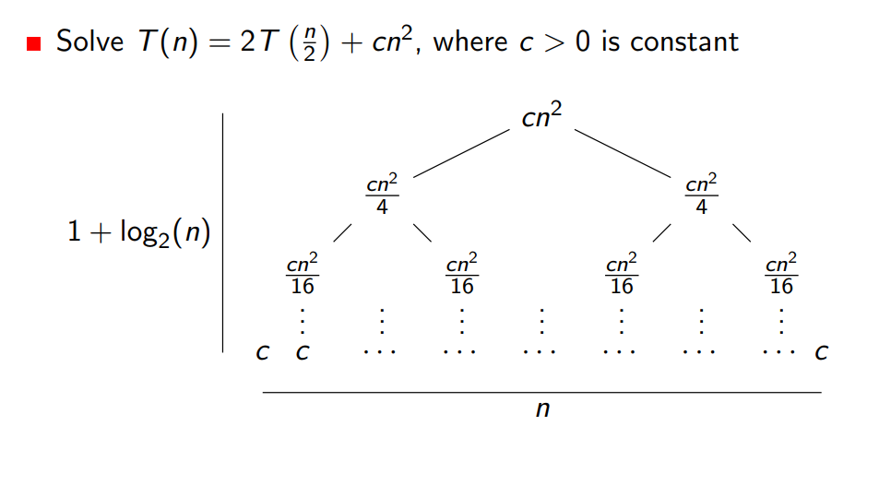
Solving Recurrences

Slide 11
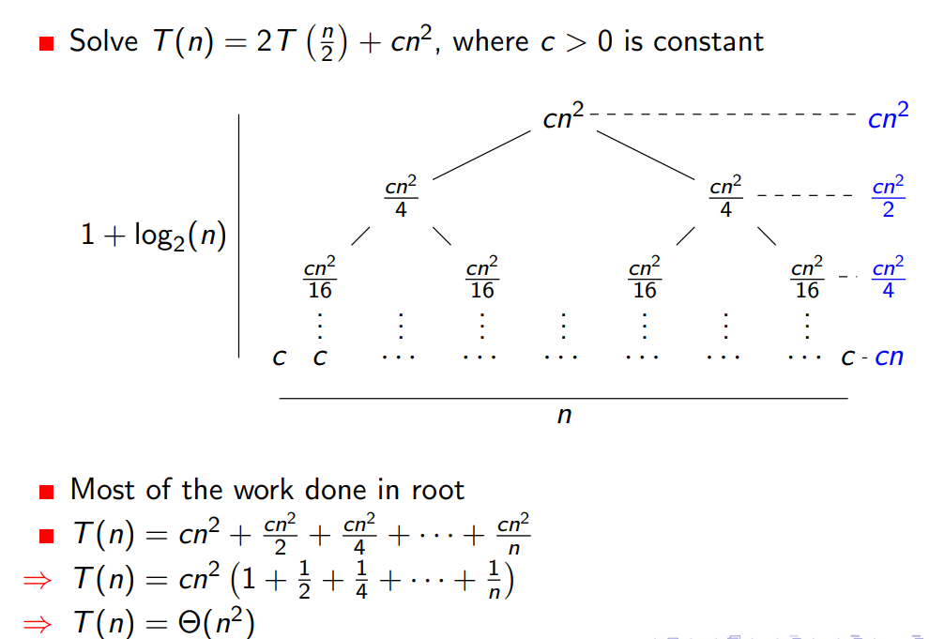
Solving Recurrences

Slide 12
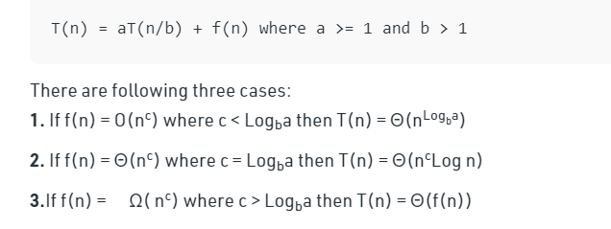
Solving Recurrences (Master Theorem)

